Slide 1
Evaluating Player Decisions
in Ethical Simulations
Thesis presentation by Trevor Hubbard

Slide 2
Table of Contents
Introduction
Methodology
Research Results
Demo
Conclusions
Acknowledgments

Slide 3
Introduction

Slide 4


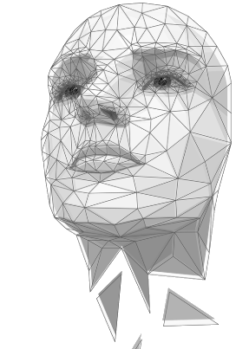



Introduction: Purpose
The need for ethical developers is absolutely essential in this day and age.

Slide 5

Introduction: Justification
A couple courses on ethics...
CS320H: Software Development Honors Colloquium
CS305: Junior Year Writing
Still, no dedicated ethics course!

Slide 6
Methodology

Slide 7
Methodology: Scenario Framework

Slide 8
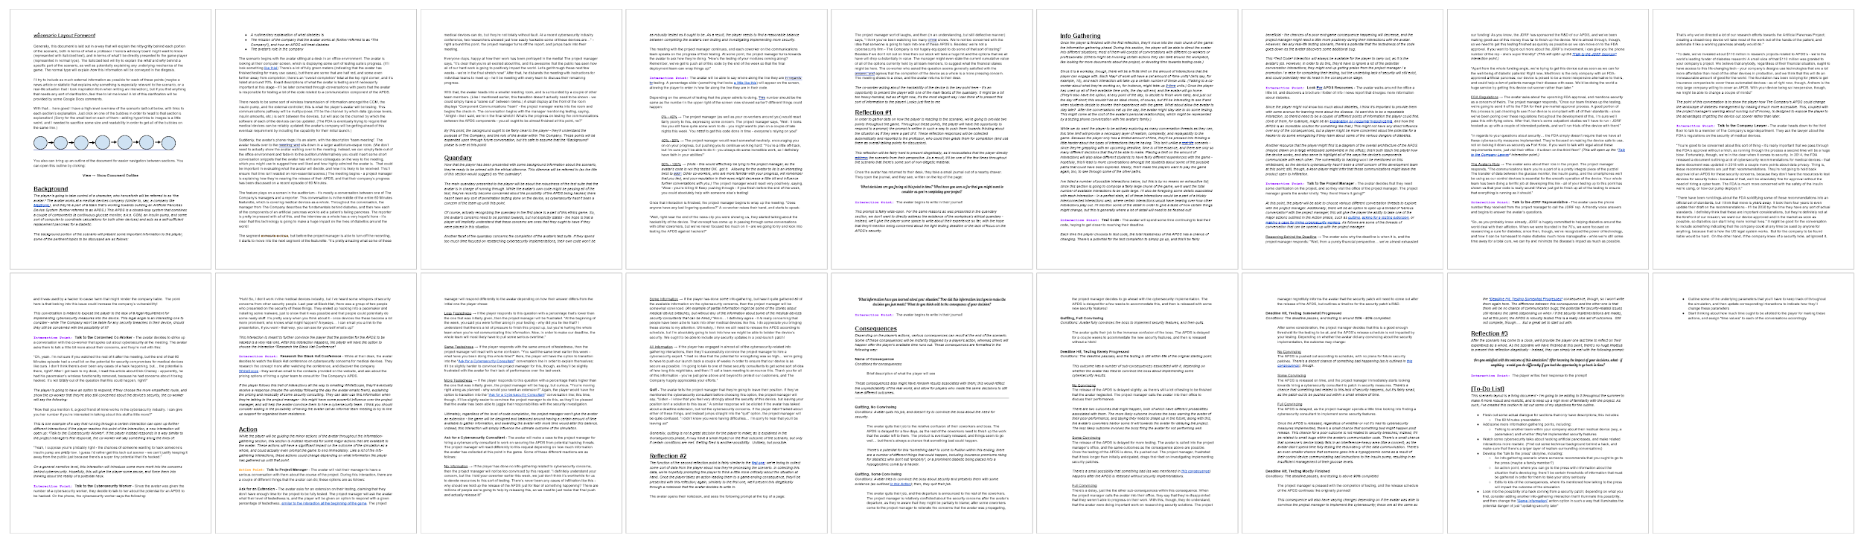
Methodology: Scenario Development

Slide 9
Research Results

Slide 10
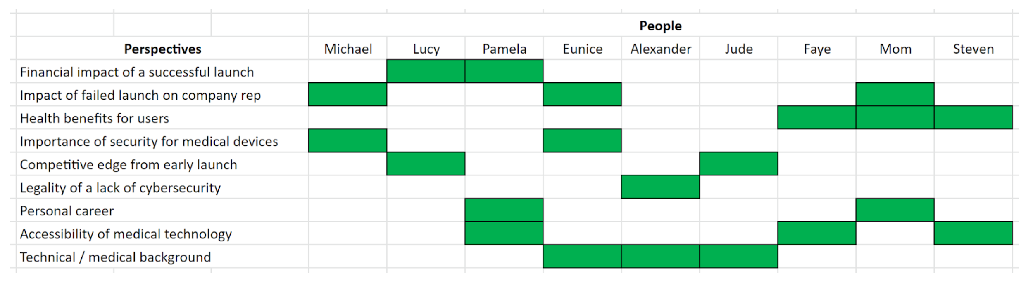
Research Results: Perspective Coverage Matrix
Perspectives
People

Slide 11
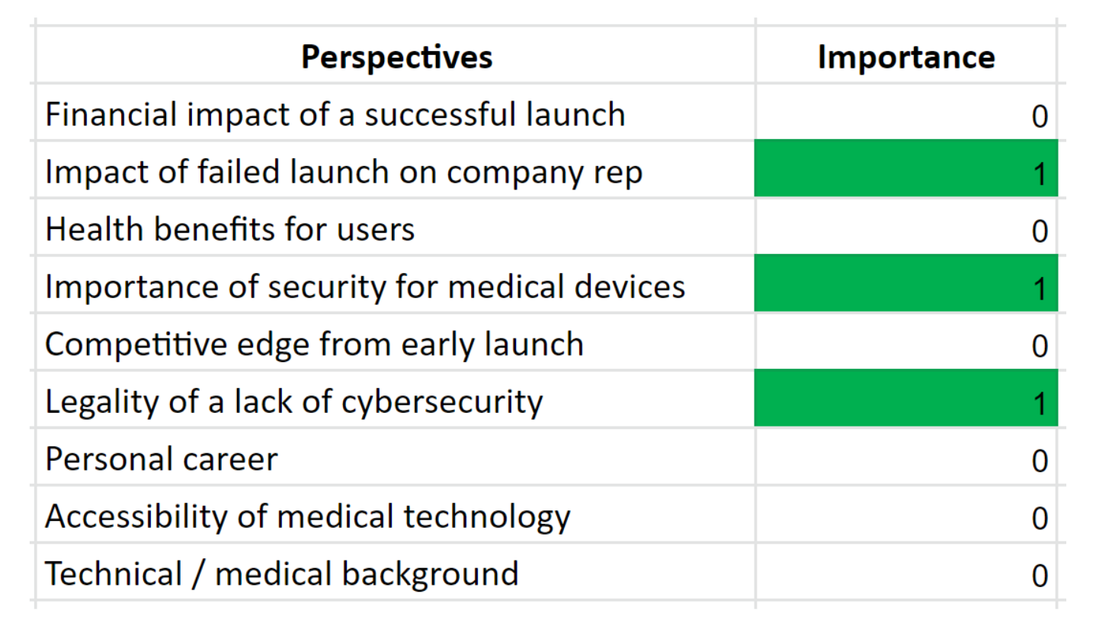
Research Results: Importance

Slide 12
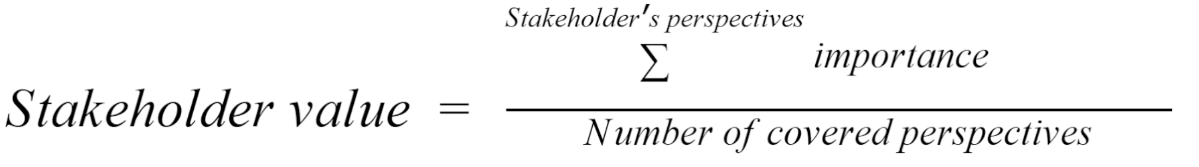
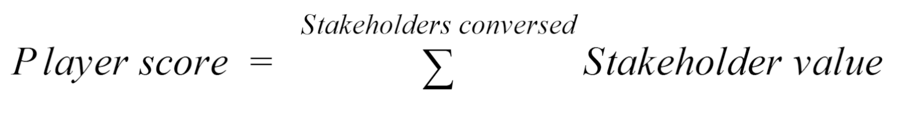
Research Results: Metrics

Slide 13
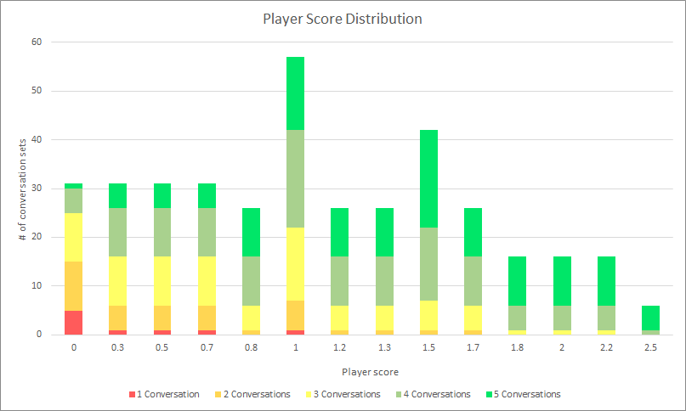
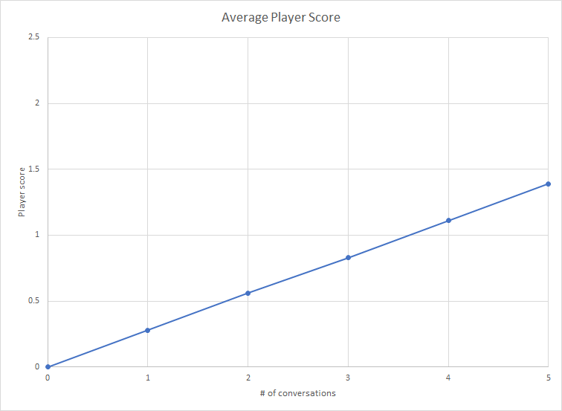
Research Results: Score Distribution

Slide 14
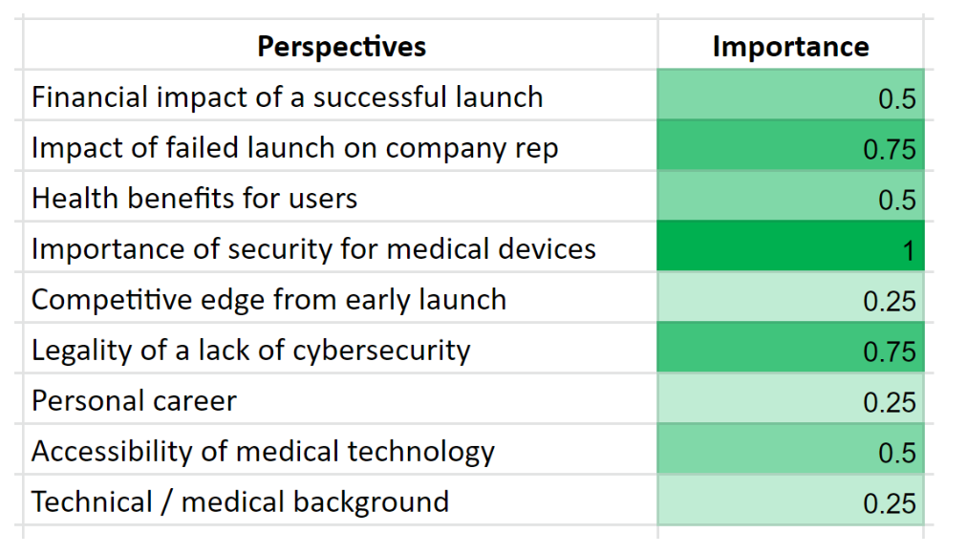
Research Results: Better Importance

Slide 15
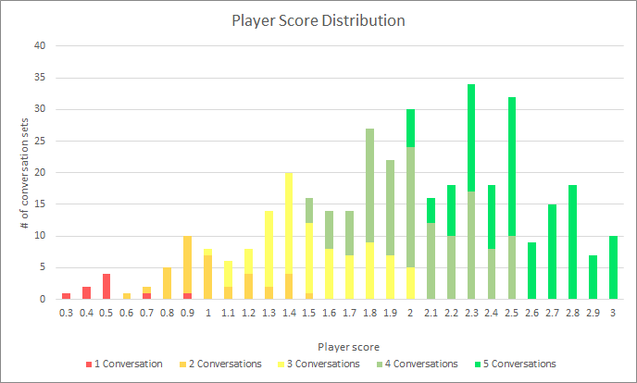
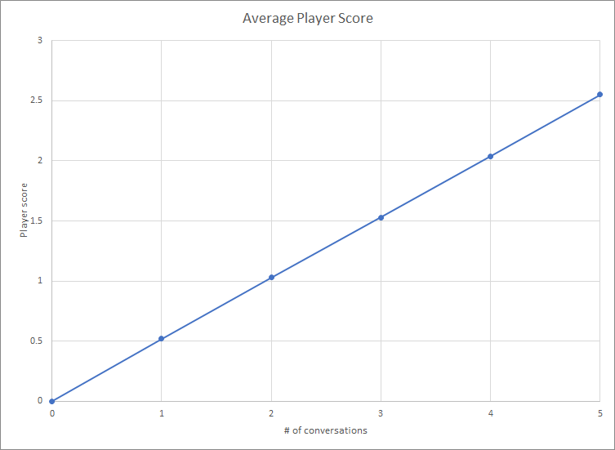
Research Results: Score Distribution 2

Slide 16
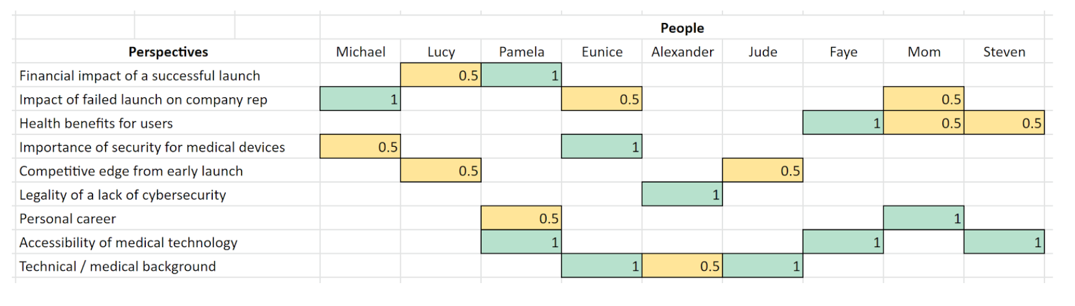
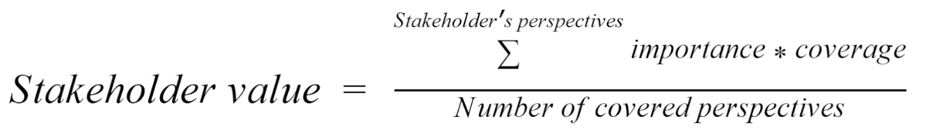
Research Results: Perspective Coverage

Slide 17
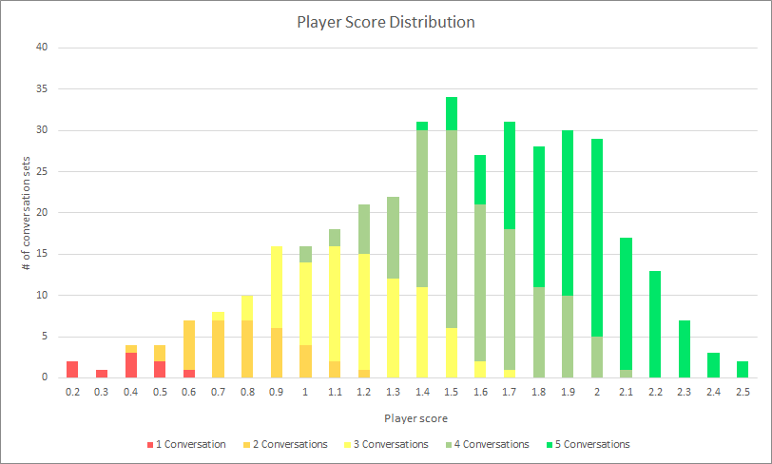
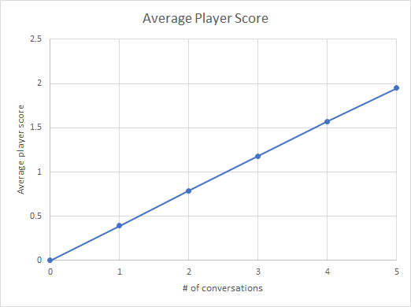
Research Results: Score Distribution 3

Slide 18
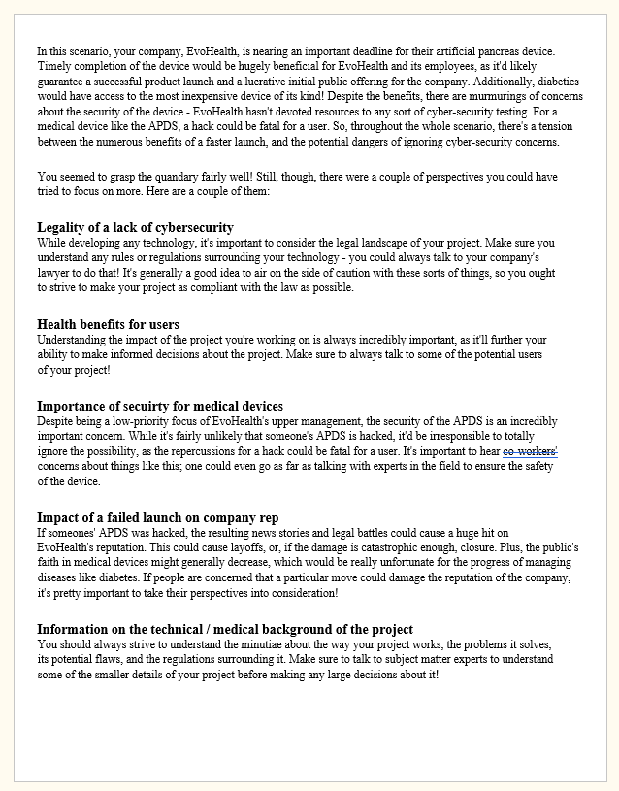
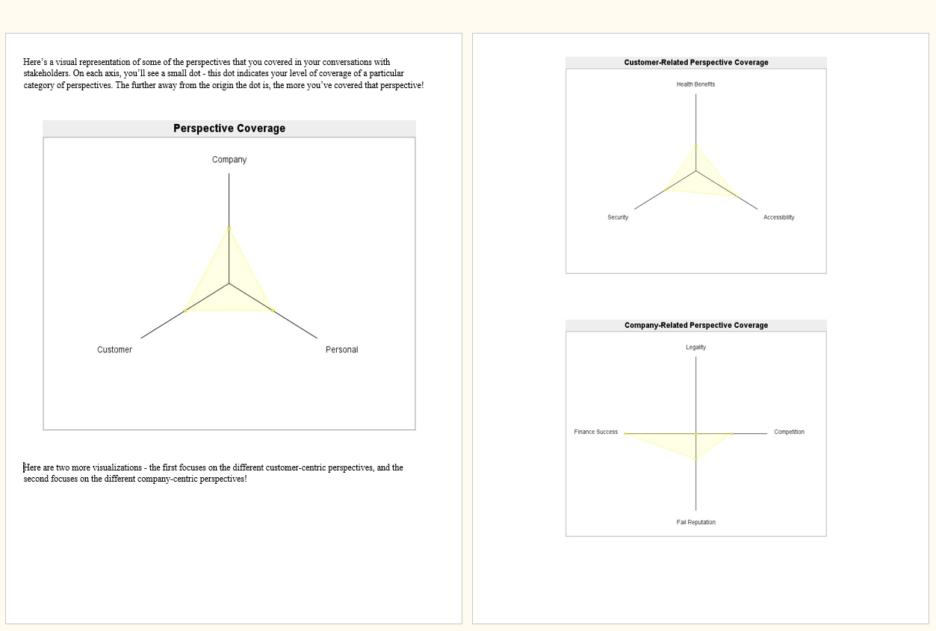
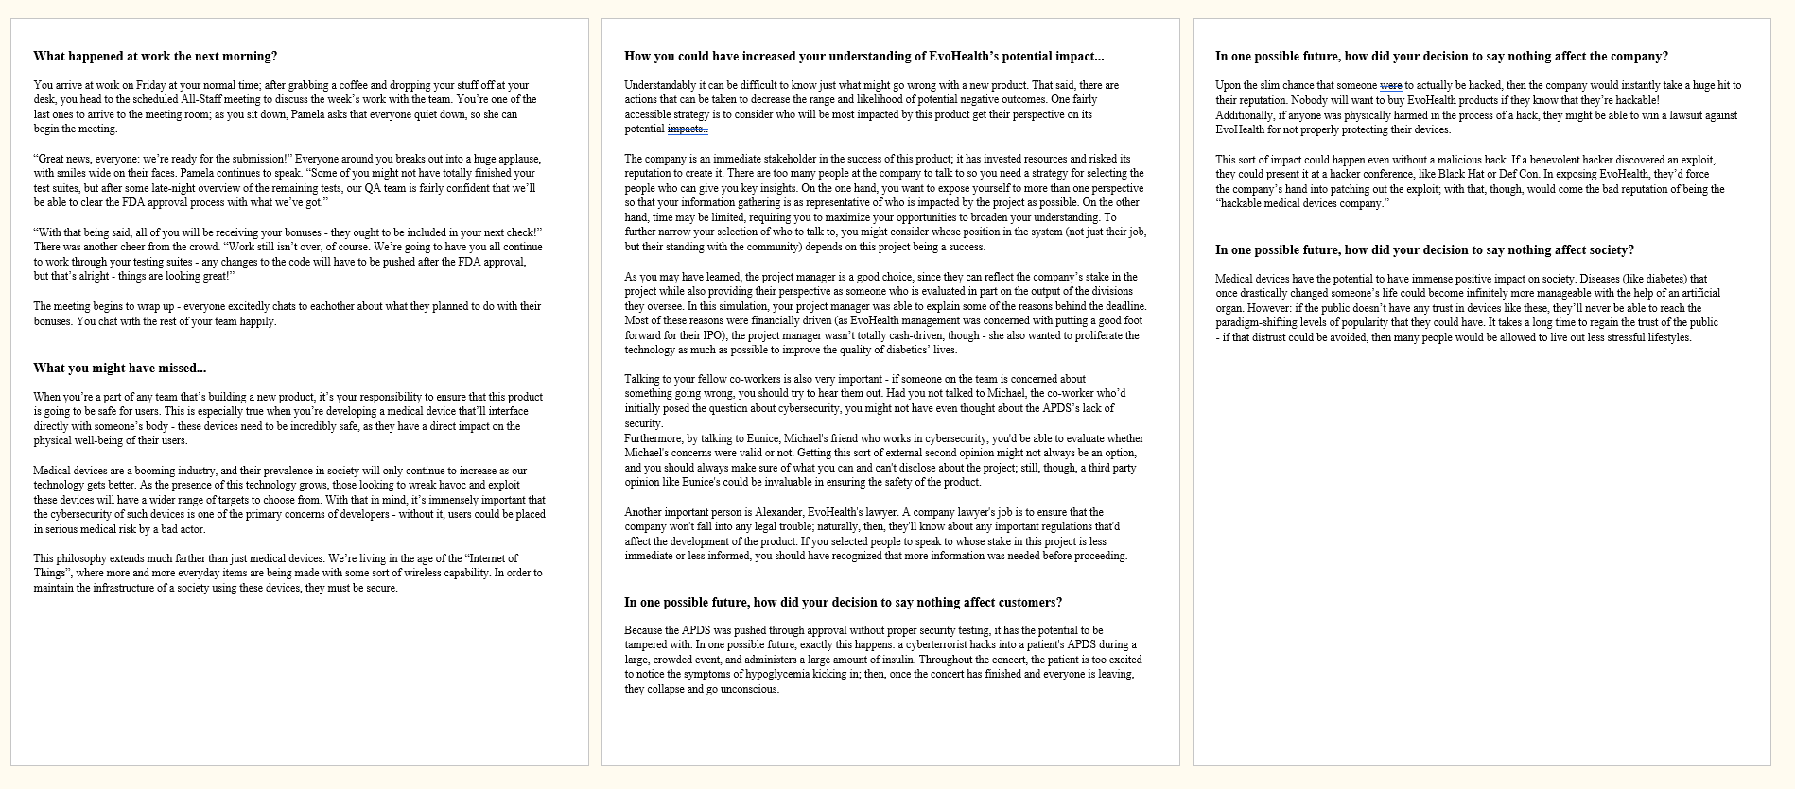
Research Results: Generating Consequences
Perspective
Evaluation
Coverage
Visualization
Scenario
Conclusion

Slide 19
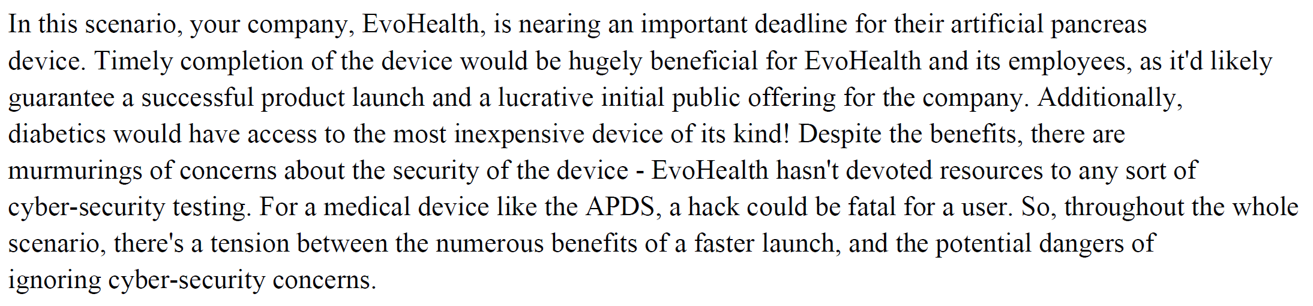
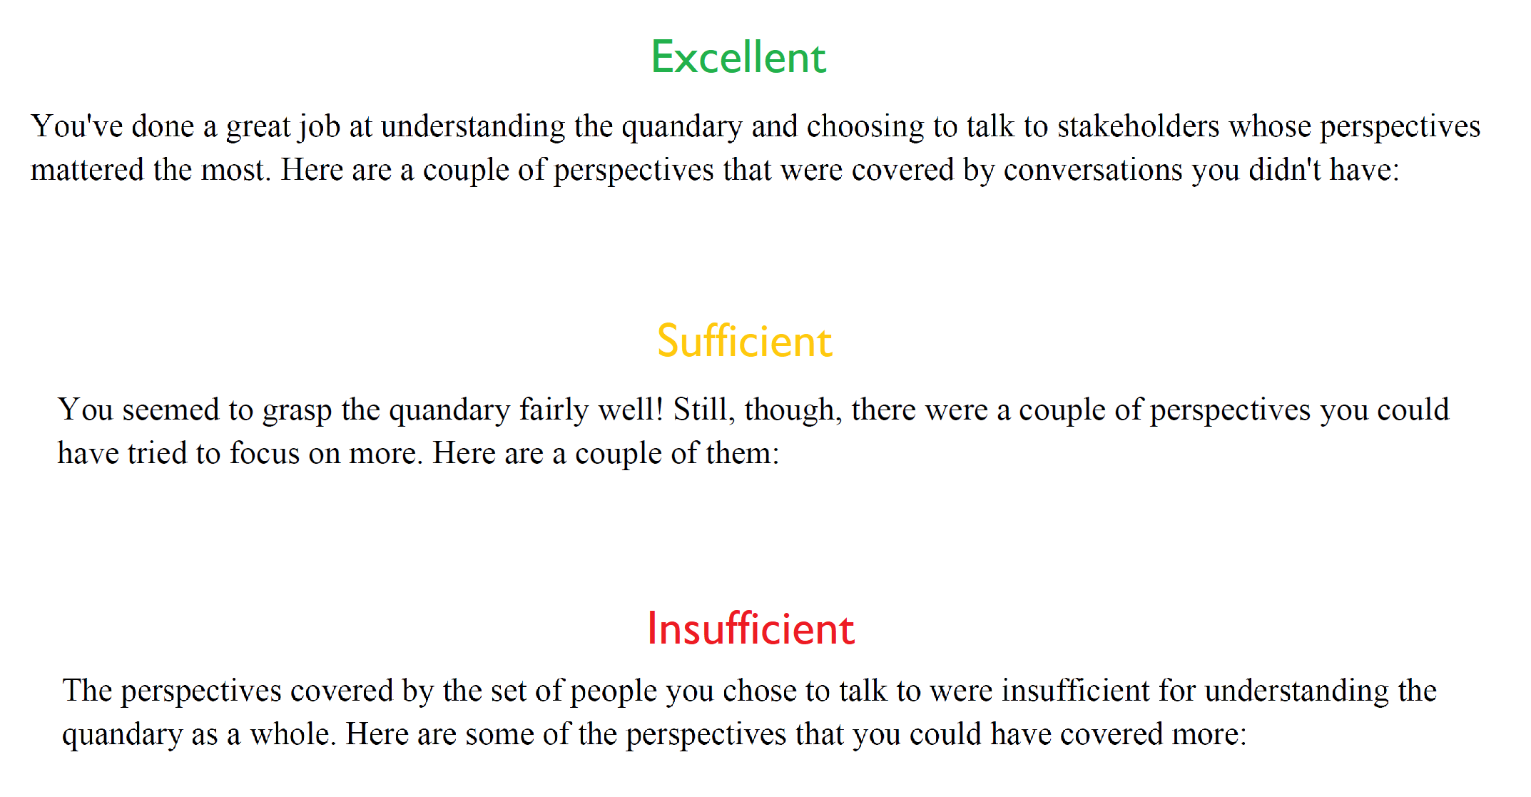
Research Results: Performance Thresholds

Slide 20
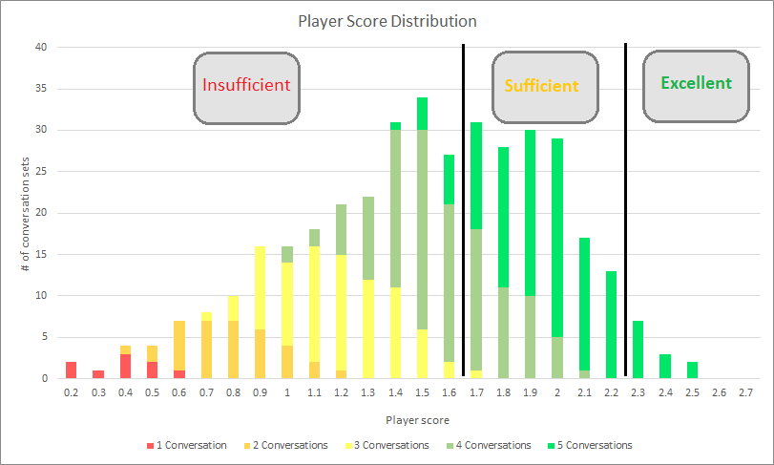
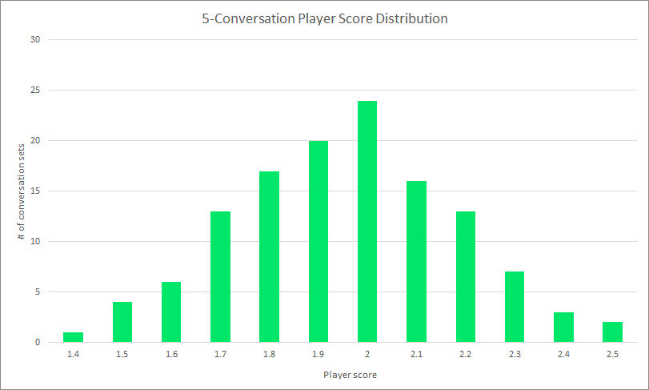
Research Results: Graphing Thresholds

Slide 21
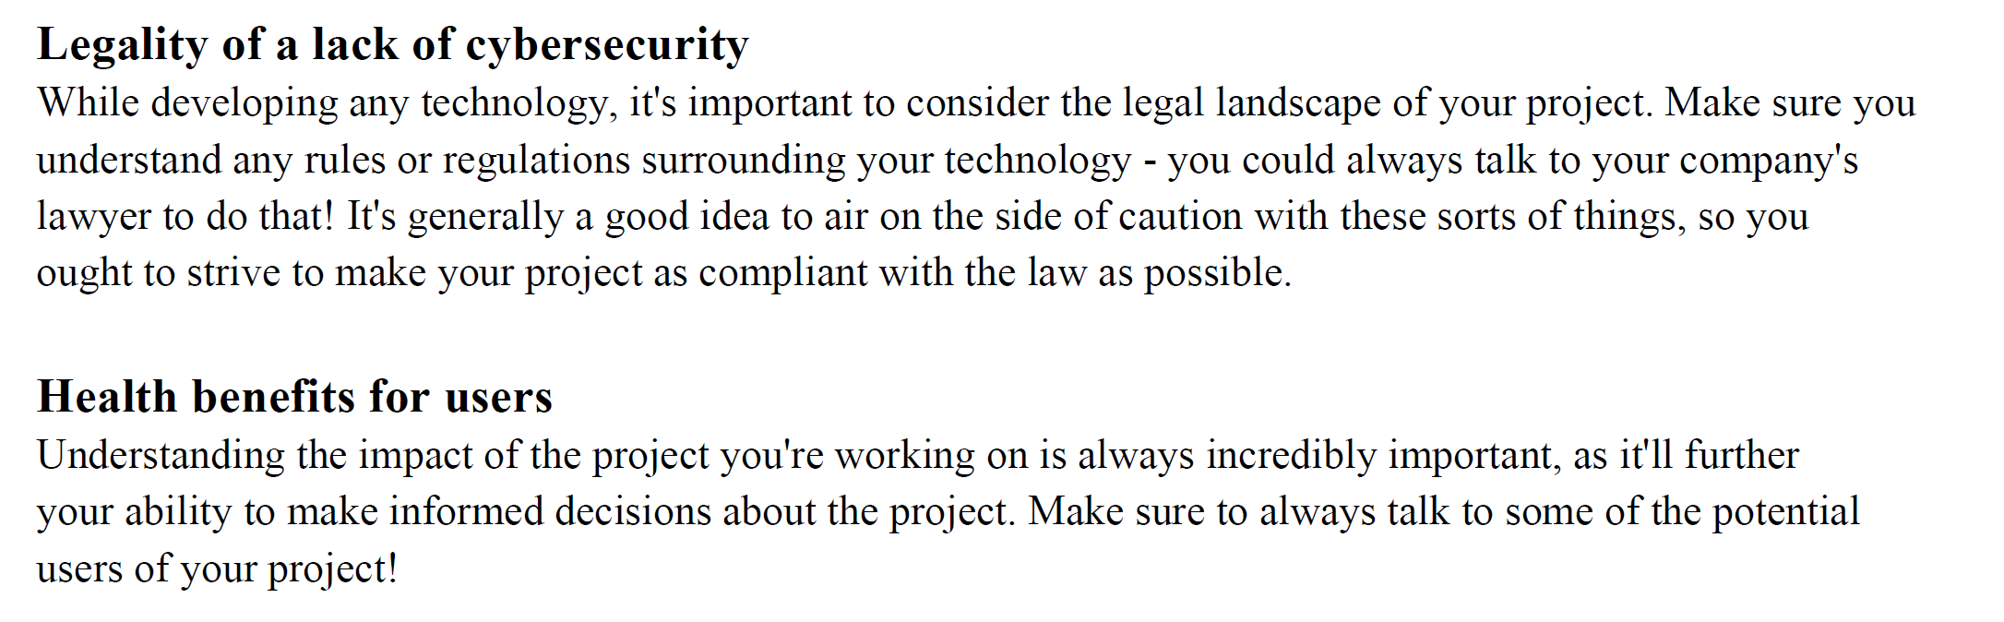
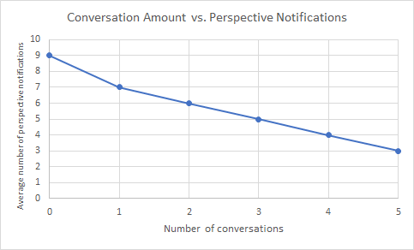
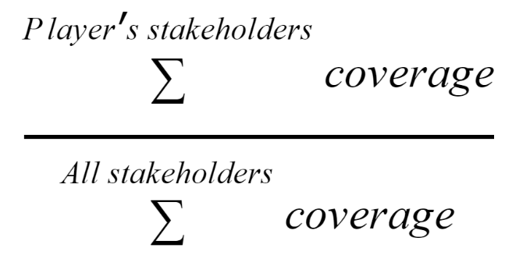
Research Results: Perspective Evaluation

Slide 22
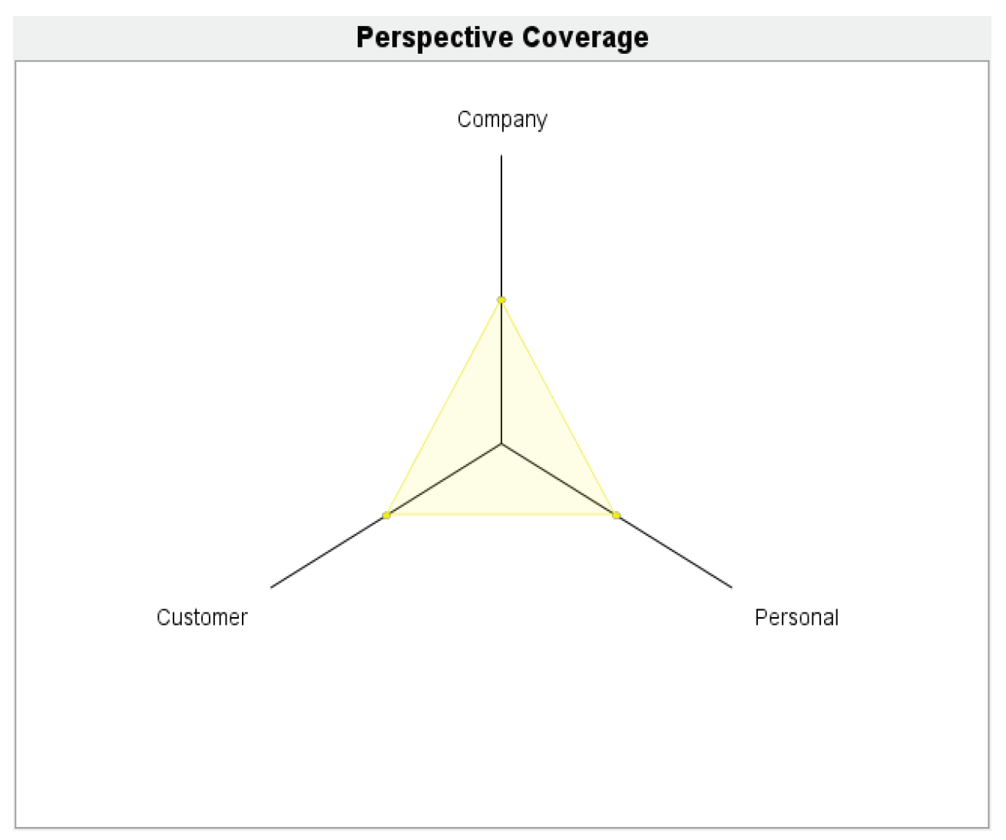
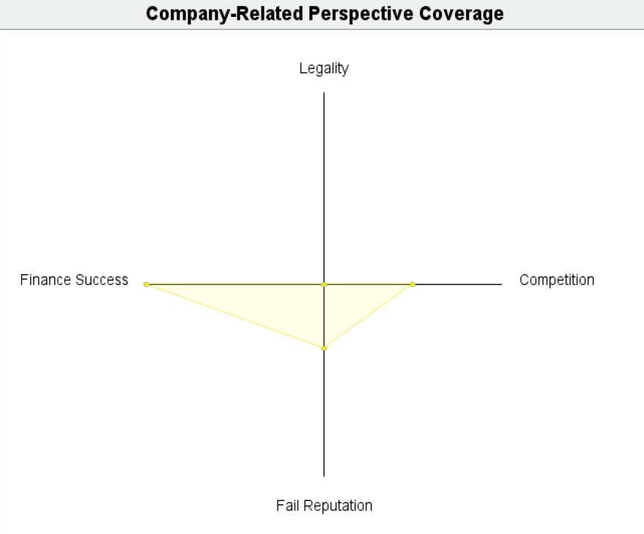
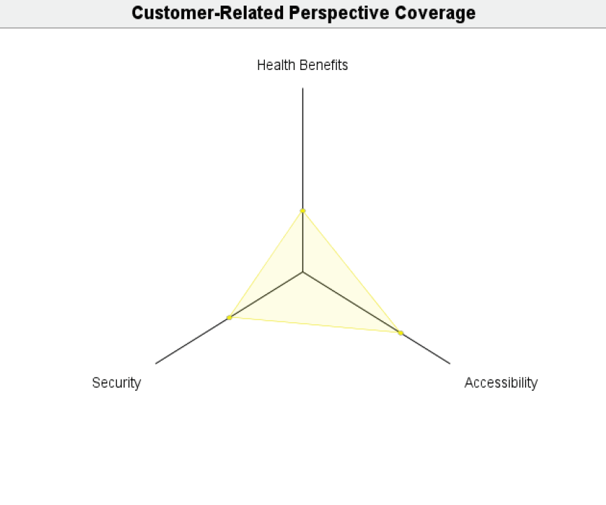
Research Results: Coverage Visualization

Slide 23
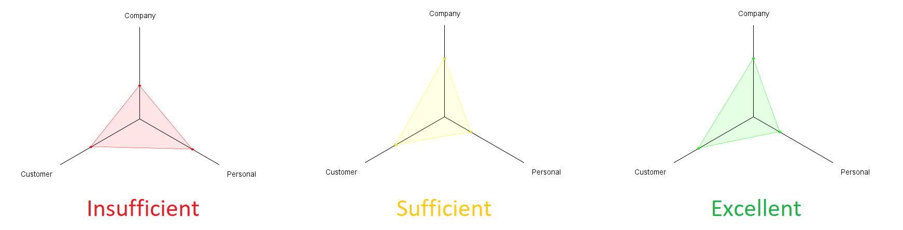
Research Results: Coverage Visualization (cont.)

Slide 24
Demo

Slide 25
Conclusions

Slide 26
Conclusions: Research Reflections
Research is an incredibly dynamic process.

Slide 27
Conclusions: Future Work
Increasing the simulation’s variability
Expanding the use of the scoring system
Moving beyond text-based delivery

Slide 28
Acknowledgments and References

Slide 29
Acknowledgments
Enormous thank you’s to Professor Osterweil, Professor Haas, Heather Conboy, Professor Trim, Jonathan Trott, and Kyle Tan!

Slide 30
References
ACM Code 2018 Task Force. 2018. ACM Code of Ethics. (June 2018). Retrieved May 19, 2019
from https://www.acm.org/code-of-ethics
Alexander Wise. 2006. Little-JIL 1.5 - Language Report. Department of Computer Science.
University of Massachusetts, Amherst, MA.
Bogost, I. (2007). Persuasive games: The expressive power of videogames. MIT Press
Cathy ONeil. 2017. Weapons of Math Destruction, New York, NY: Broadway Books.
Gibson, David, and Karen Schrier. Designing Games for Ethics: Models, Techniques and
Frameworks. Information Science Reference, 2011.
Sicart, Miguel. The Ethics of Computer Games. MIT Press, 2011.

